Slide 1
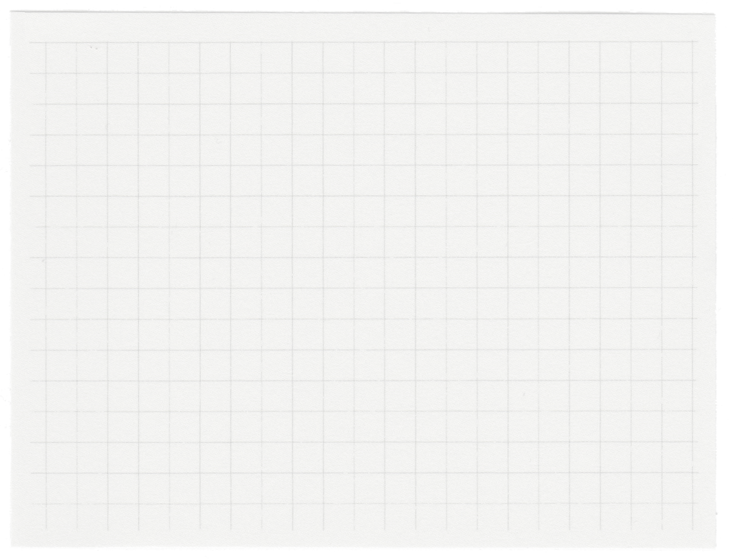







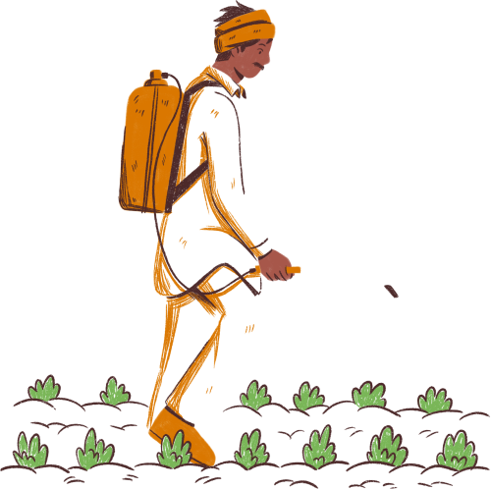
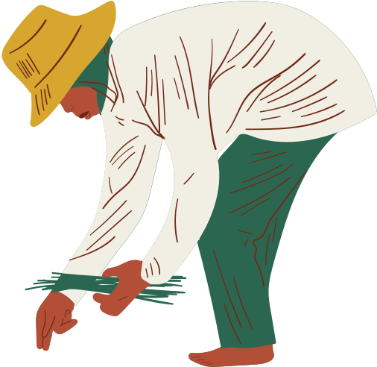
CROPQUEST
Empowering Farmers Through Data-Driven Insights
Team Name: FarmFusion
Team Members: Abhiram Laha
Shubham Keshari
Faizan Raza
Tathagata Das
College Name: Future Institute of Engineering & Management

Slide 2



Problem Statement:
Challenges in agriculture like suboptimal crop choices,
incorrect fertilizer use, and low yields.
Objectives:
Provide crop Data-driven crop recommendations tailored to local soil and weather conditions.
Accurate fertilizer suggestions to balance soil nutrients and improve yield.
Insights into crop yield predictions based on historical data and advanced machine learning models.
Significance:
Promotes sustainable farming, enhances profitability, and offers an accessible, user-friendly platform for informed decisions.

Slide 3


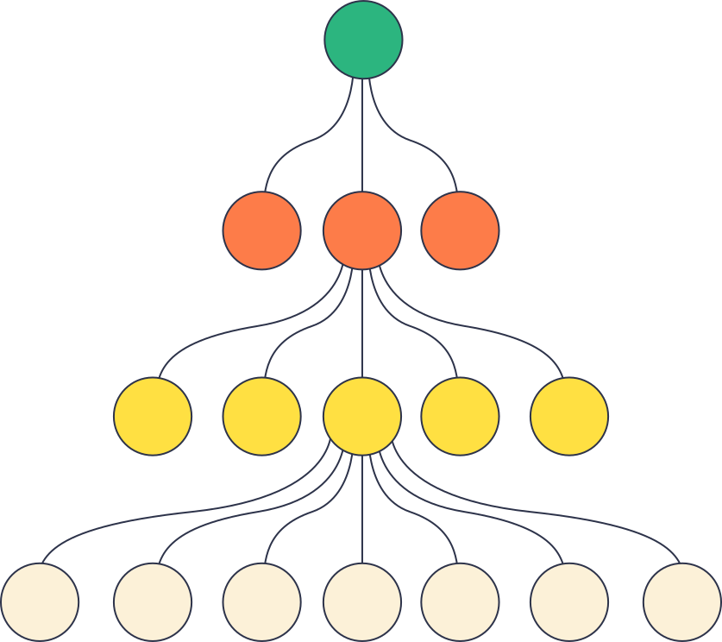
Crop Recommendation:
Provides optimal crop choices based on soil type, weather conditions, and historical data to maximize efficiency.
Fertilizer Suggestions:
Offers precise recommendations for nitrogen (N), phosphorus (P), and potassium (K) levels tailored to the crop's needs.
Promotes balanced nutrient application, enhancing soil health and reducing waste.
Crop Yield Prediction:
Utilizes regression models to predict potential yield based on inputs like soil quality, weather patterns, and crop type.
Helps farmers estimate output and plan resources effectively.

Slide 4



Technologies & Tools Used
HTML | CSS: Used to design the responsive and interactive user interface.
Flask: Python web framework for backend development and app deployment.
Pandas: For data processing and manipulation of large datasets.
NumPy: For performing numerical operations and handling arrays efficiently.
Scikit-learn: For building and evaluating machine learning models.
Matplotlib | Seaborn: Libraries for creating visualizations like graphs and charts.
Jupyter Notebook: Interactive environment for running code, data analysis, and visualization.
Kaggle: A platform for sourcing and downloading datasets used in the project.

Slide 5


Working – Crop Recommendation
Data Collection:
Gathered historical data on soil properties, weather, and crop yields.
Preprocessing:
Cleaned data, normalized attributes, and encoded soil types for analysis.
Model Selection:
Used Random Forest Classifier for its high accuracy and ability to handle non-linear data.
Model Training:
Trained the model with an 80:20 train-test split, achieving 90% accuracy.
Prediction Process:
Input: Soil type, pH level, weather data.
Output: Suggests the optimal crops based on suitability.
Deployment:
Integrated the model into a Flask app for real-time recommendations.

Slide 6
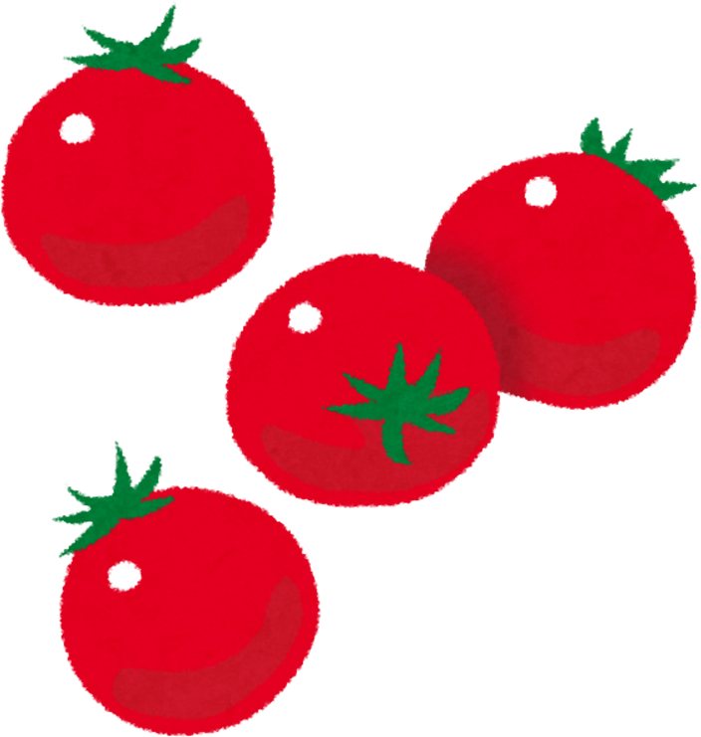

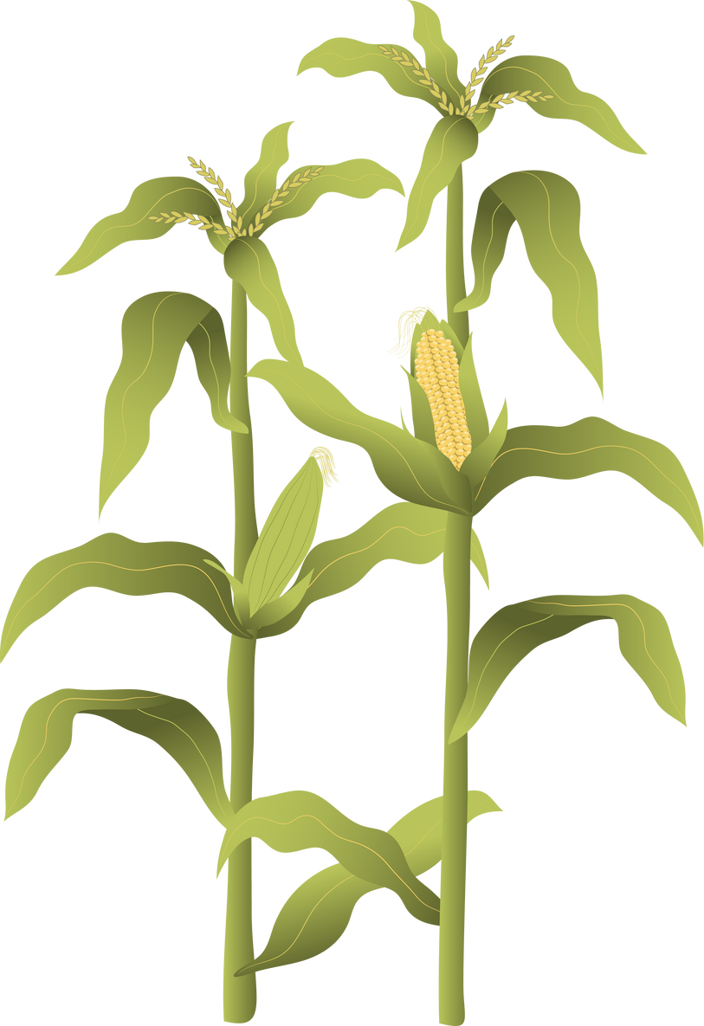

Conclusion:
CropQuest provides farmers with data-driven crop recommendations, tailored fertilizer suggestions, and accurate yield predictions, empowering them to make informed decisions for better agricultural outcomes.
Future Scope:
Crop Disease Classification: Integrate Deep Learning models (CNNs) for early disease detection in crops, enabling proactive measures to reduce crop loss and improve productivity.
Real-time Soil Monitoring: Incorporate IoT sensors for continuous soil condition analysis and real-time recommendations.

Slide 7

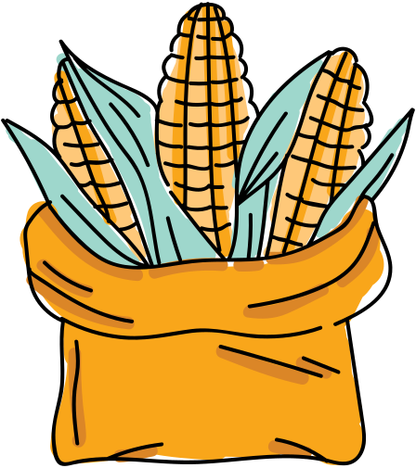
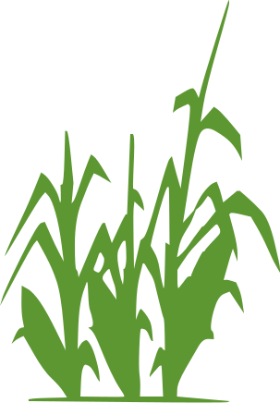
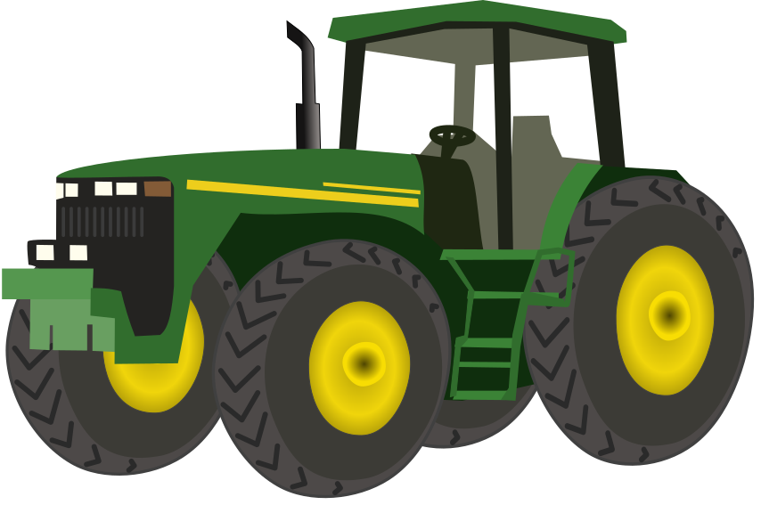
Thank you very much!
cropquest.onrender.com

